Slide 1
Drinking Detection

Slide 2
Platform
Item
Raspberry-pi A+
Small
Can install OS
Many GPIO
Low power consumption
Micro SD
Network
Sensor
FSR406
SHT10
MCP3008
Power Supply
Wifi Dongle

Slide 3
Code on board
Import GPIO to use GPIO
Import Sht1x to use sht10 easier.
Import SPI (Serial Peripheral Interface Bus) to use MCP3008
Import subprocess to execute command of delivering.

Slide 4
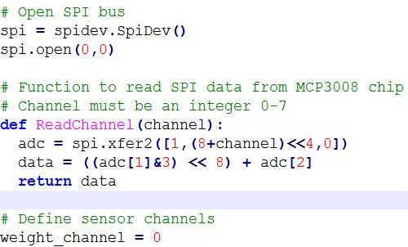
Code on board (cond.)
MCP3008

Slide 5
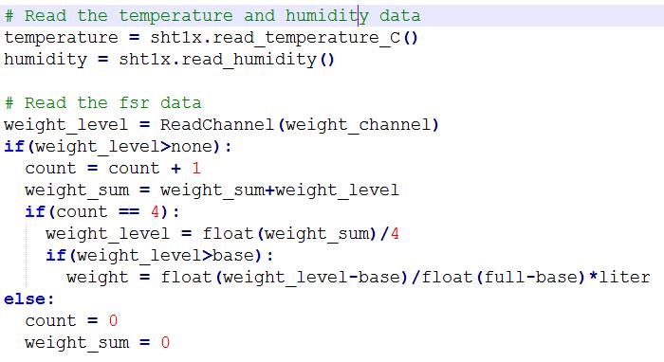
Code on board (cond.)
Sensors

Slide 6
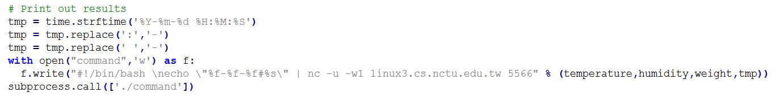
Code on board (cond.)
Format of time
Write command
Exectue command

Slide 7
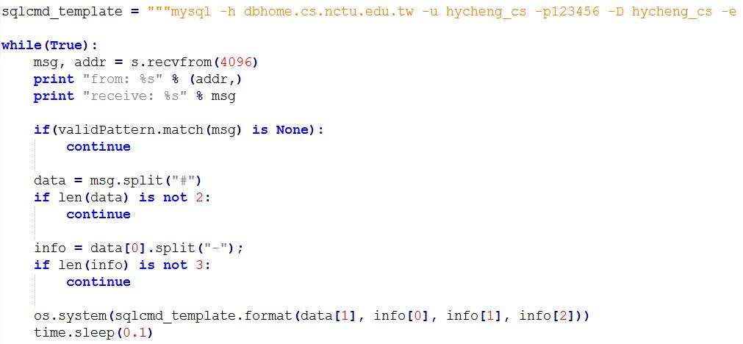
Code on server
Catch data from board
Save to database

Slide 8

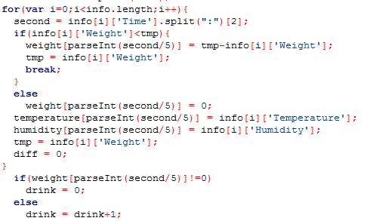
Code on server(cond.)
Request data between lastUpdate Time and Current Time.
Parse data and update data
Count time of not drinking

Slide 9
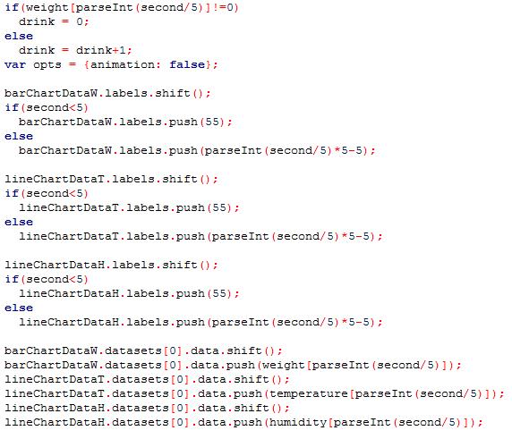
Code on server(cond.)
Chart shifting

Slide 10
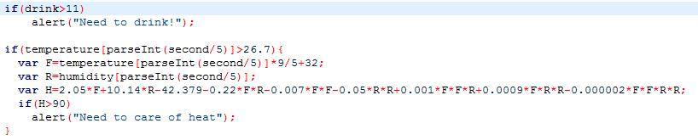
Code on server(cond.)
Alert of drinking and heat.

Slide 11
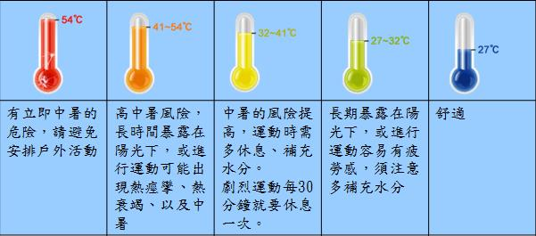
Demo
If not drinking in 1 minute, there is an alert of drinking.
If heat index is over 90°F (32°C), there is an alert of heat.

Slide 12
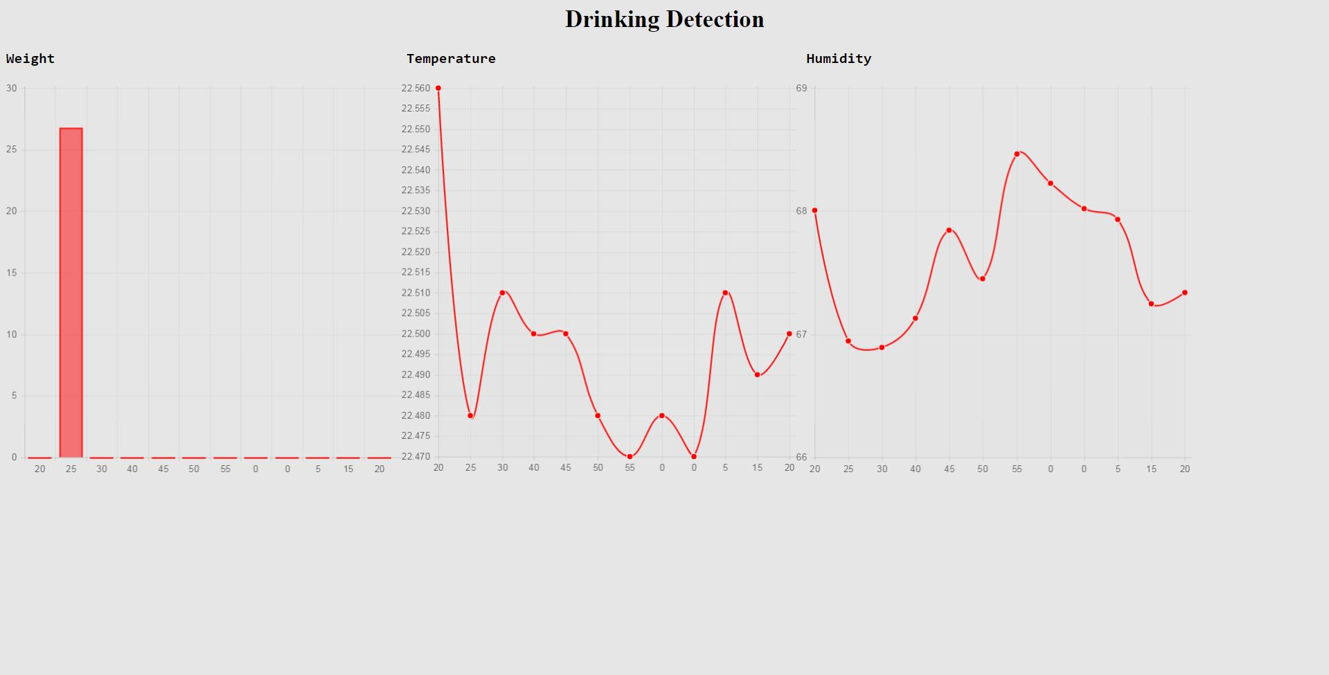
Demo
Need to drink

